Slide 1
Unlocking the Power of Hybrid Workforce – Process Orchestration State of the Market 2023
February 2023: Complimentary Abstract / Table of Contents

Slide 2
Our research offerings
This report is included in the following research program(s): Service Optimization Technologies, Process Orchestration
Amazon Web Services (AWS) | Exponential Technologies | Microsoft Azure Membership Program
Application Services | Finance and Accounting | Modern Application Development (MAD)
Artificial Intelligence (AI) | Financial Services Technology (FinTech) | Mortgage Operations
Asset and Wealth Management | GBS Talent Excellence | Multi-country Payroll
Banking and Financial Services Business Process | Global Business Services | Network Services and 5G
Banking and Financial Services Information Technology | Google Cloud | Outsourcing Excellence
Catalyst™ | Healthcare Business Process | Pricing Analytics as a Service
Clinical Development Technology | Healthcare Information Technology | Process Mining
Cloud and Infrastructure | Human Resources | Process Orchestration
Contingent Staffing | Insurance Business Process | Procurement and Supply Chain
Contingent Workforce Management | Insurance Information Technology | Recruitment
Customer Experience Management Services | Insurance Technology (InsurTech) | Retail and CPG IT Services
CX Excellence | Insurance Third-Party Administration (TPA) Services | Retirement Technologies
CXM Technology | Intelligent Document Processing | Revenue Cycle Management
Cybersecurity | Interactive Experience (IX) Services | Rewards and Recognition
Data and Analytics | IT Services Excellence | Service Optimization Technologies
Digital Adoption Platforms | IT Services Executive Insights™ | Software Product Engineering Services
Digital Engineering Services | IT Talent Excellence | Supply Chain Management (SCM) Services
Digital Services | Life Sciences Business Process | Sustainability Technology and Services
Digital Workplace | Life Sciences Commercial Technologies | Technology Skills and Talent
Employee Experience Management (EXM) Platforms | Life Sciences Information Technology | Trust and Safety
Employer of Record (EOR) | Locations Insider™ | Value and Quality Assurance (VQA)
Engineering Services | Marketing Services | Work at Home Agent (WAHA) Customer Experience Management (CXM)
Enterprise Platform Services | Market Vista™
If you want to learn whether your organization has a membership agreement or request information on pricing and membership options, please contact us at info@everestgrp.com
Learn more about our
custom research capabilities
Benchmarking
Contract assessment
Peer analysis
Market intelligence
Tracking: providers, locations, risk, technologies
Locations: costs, skills, sustainability, portfolios

Slide 3
1. | Introduction and overview | 6
 | Research methodology | 7
 | Key sources of information | 8
 | Background of the research | 9
 | Outlook for 2023 | 11
2. | Summary of key messages | 13
3. | Overview of process orchestration | 17
 | Intelligent Automation (IA) ecosystem | 18
 | Process orchestration definition | 19
 | Product components and capabilities | 20
 | Applications and benefits of process orchestration | 21
 | Process orchestration use cases | 23
4. | Market size and adoption trends | 25
 | Process orchestration software market size and growth by revenue | 26
 | Adoption by buyer geography | 27
 | Adoption by buyer industry | 28
 | Adoption by business process/function | 29
5. | Buyer expectations | 30
 | Drivers for process orchestration adoption | 31
 | Overall buyer satisfaction | 32
 | Key strengths and areas of improvement | 33
Amardeep Modi, Vice President
Samikshya Meher, Practice Director
Jonty Padia, Senior Analyst
Santhosh Kumar, Senior Analyst
Varun Jain, Analyst

Slide 4
 | Key barriers to adoption | 34
 | Best practices | 35
6. | Process orchestration solution characteristics | 36
 | Elements of solution characteristics | 37
 | Training & support | 38
 | Talent | 39
 | Partner ecosystem | 41
 | Deployment model | 44
 | Commercial model | 45
7. | Process orchestration product capabilities and trends | 47
8. | The process orchestration market – competitive landscape | 54
 | Summary | 55
 | Market share – by revenue | 56
 | Market share – by client | 57
 | Top process orchestration technology providers – by industry | 58
 | Top process orchestration technology providers – by geography | 59
 | Top process orchestration technology providers – by business function | 60
 | Top process orchestration technology providers – by buyer segment | 61
9. | Appendix | 62
 | Glossary | 63
 | Research calendar | 65

Slide 5
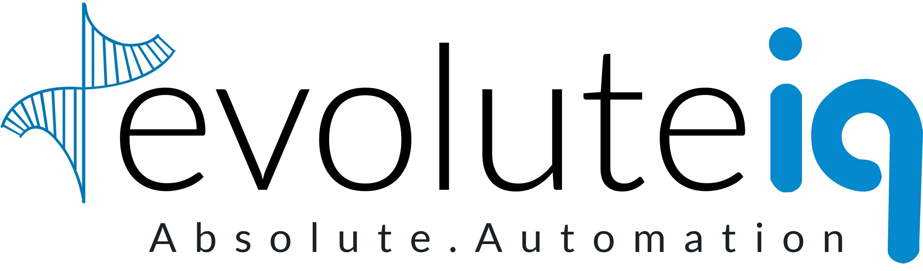
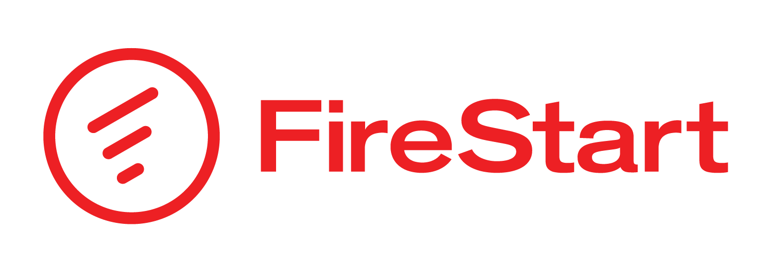
This research is based on multiple sources of proprietary information
Proprietary database of 18 process orchestration technology providers The database tracks the following elements of each contract: Process design and business rules management Low-code/No-code user interface, hybrid workforce management Monitoring & analytics, interoperability Partnerships with service providers and other technology providers
Proprietary operational information database of technology providers (updated annually) The database tracks the following for each provider: Revenue and number of FTEs Number of clients FTE split by different lines of business
Demonstrations and interactions with technology providers and other industry stakeholders Detailed demonstrations for a comprehensive product view and executive-level discussions with process orchestration providers that cover: Current state of the market Vision and strategy Opportunities and challenges
Buyer reference interviews, ongoing buyer surveys, and interactions Interviews with technology providers’ reference clients and enterprise process orchestration buyers to get the buyer perspective around: Drivers and objectives for adopting process orchestration Apprehensions and challenges Assessment of providers’ performance
Providers assessed¹
Deployment and hosting options
Product-related training and support services
Availability and adoption of commercial model(s)
IT governance and security
Portfolio coverage in terms of industry, geography, process areas, and buyer size
Emerging areas of investment
Annual performance and future outlook
Emerging priorities / buying criteria
Outcomes achieved
Lessons learned and best practices adopted
1 Assessment for Bonitasoft, Microsoft, and Pega excludes detailed provider inputs for this particular study and is based on Everest Group’s estimates that leverage Everest Group’s proprietary Transaction Intelligence (TI) database, ongoing coverage of these technology providers, their public disclosures, and interaction with buyers. For these companies, Everest Group’s data for assessment may not be complete
The source of all content is Everest Group unless otherwise specified
Confidentiality: Everest Group takes its confidentiality pledge very seriously. Any information we collect that is contract specific will only be presented back to the industry in an aggregated fashion

Slide 6
Introduction
Everest Group defines Process Orchestration (PO) as software that helps business users design, manage, and monitor end-to-end business processes. It includes key capabilities such as process modeling, business rules management, the ability to design user interfaces for capturing/presenting data, hybrid (human + digital) workforce management, and the ability to provide process-related insights. It should be able to orchestrate the flow of work across human workers, digital workers (such as RPA, IDP, and conversational AI), and enterprise applications in long-running workflows.
For the scope of this study, we cover products in the market that are low-code / no-code and broad-based business process-centric products (not focused on a particular use case / function / industry) and are available for independent licensing. The product should also be capable of handling workflows that may not involve digital workers.
In this study, we investigate the state of the process orchestration market and focus on:
Overview of process orchestration
Market size and adoption trends across buyer geography, industry, and business function
Buyer expectations including barriers to adoption, and best practices
Process orchestration solution characteristics and key product capabilities and trends
Process orchestration provider landscape
Outlook for 2023
Scope of this report
 | Geography |  | Industry |  | Product
 | Global |  | All key markets |  | Process orchestration

Slide 7
Overview and abbreviated summary of key messages (page 1 of 2)
This report provides process orchestration buyers, software providers, and third-party enablers (service providers, system integrators, etc.) a detailed overview of the process orchestration software and analyzes the process orchestration market across various dimensions including market size and adoption trends, buyer expectations including key barriers to adoption and best practices, solution characteristics, product capabilities & trends, technology provider landscape, and outlook for 2023
Some of the findings in this report, among others, are:
Overview of process orchestration
Process orchestration software provides capabilities for the design and management of end-to-end processes along with process and workforce insights. It should be able to orchestrate the flow of work across human workers, digital workers (such as RPA, IDP, and conversational AI), and enterprise applications in long-running workflows
Enterprises adopt process orchestration solutions for several applications including process standardization, workflow automation, and process optimization and it offers several benefits including cost and operational efficiencies, leading to greater demand among enterprises
Market size and adoption trends
The process orchestration software market stood at almost US$2.4 billion in 2021, experiencing a YoY growth of over 20% due to the rapid spread of digital transformation all over the world
While North America continues to hold a dominant share of the process orchestration market, the UK experienced strong growth in adoption
Banking and capital markets, manufacturing, CPG & retail, and high-tech & telecom industries have experienced strong growth in adoption post the pandemic
Buyer expectations
Buyers have indicated a high level of satisfaction with the providers on their overall performance, though there is further scope to improve product training and support
Lack of overall as-is process visibility, internal resistance, lack of stakeholder alignment, measuring RoI, and inadequate technology awareness are the main barriers to the adoption of process orchestration solutions

Slide 8
Overview and abbreviated summary of key messages (page 2 of 2)
Process orchestration solution characteristics
Process orchestration providers are delivering role-based and version-specific training through online training portals. To facilitate product support, they are increasingly enabling online user communities
North America and APAC together account for over 65% of the total process orchestration FTEs, indicating a strong talent pool in these regions
Process orchestration providers leverage technology partners to enhance access to complementary capabilities and service providers for the reselling, training, and implementation of their products
Process orchestration provider landscape
Appian, Nintex, and Pega are the top providers in terms of process orchestration license revenue
Appian and Nintex are among the leading providers across all the key verticals, while Microsoft and Pega are the other providers with high market share across industries
Appian and Pega have a strong presence across all geographies. Nintex and Microsoft are other dominant providers across major geographies
Outlook for 2023
The process orchestration market is experiencing accelerated growth, with an increased enterprise focus on designing and orchestrating business processes to enhance operational efficiency, resilience, and agility
Process orchestration providers continue to invest in low-code/no-code UI capabilities that are empowering citizen developers to build responsive forms and process-centric applications
Process orchestration providers are focusing on forging partnerships with or developing in-house capabilities for complementary technologies such as RPA, IDP, process mining, and conversational AI, to enable innovative features such as the ability to orchestrate processes that involve unstructured documents and customer interactions
Process orchestration providers are expected to further increase their focus on evangelizing the technology through various events, workshops, and thought leadership initiatives to create awareness and share best practices with enterprises

Slide 9
This study offers nine distinct chapters providing a deep dive into key aspects of RPA market; below are four charts to illustrate the depth of the report
Process orchestration software market size and adoption trends | Buyer expectations
Process orchestration solution characteristics | Process orchestration provider landscape
XX%
Actual growth rate
XX%
Expected CAGR
Key factors driving process orchestration adoption
Importance on a scale of 1 to 7
Relevance of the driver for clients (2022)
15-20%
The process orchestration software market stood at almost US$2.4 billion in 2021, experiencing a YoY growth of over 20% due to the rapid spread of digital transformation all over the world
This trend of accelerated growth in the process orchestration software market is expected to continue in the next couple of years. The growth rate slowed down in the second half of 2022 due to the economic downturn
The key growth drivers for process orchestration adoption include the increased focus on digitization, the demand for a unified view of processes, and the need for managing the digital workforce as enterprises scale their automation initiatives
2022
Subdimensions
Provider
performance
17-22%
Improving operational efficiency and quality
6.2
20-25%
Operational impact
6.4
Improving process governance & compliance
6.2
Improving employee/workforce productivity
6.1
Enhancing employee experience
5.7
5.9
Increasing top-line growth
6.0
Strategic impact
Enhancing customer experience
5.9
Improving the RoI of transformation initiatives
5.9
//
Cost impact
5.9
Cost savings
5.4
Providers’ process orchestration software market share by revenue
(providers are listed in alphabetical order within each category)
>10%
5-10%
1-4%
<1%
Process orchestration solution characteristics
Training & support
Talent
Partner ecosystem
Deployment
model
Commercial model

Slide 10
Research calendar Service Optimization Technologies (SOT)
Published
Planned
Current release
Reports title | Release date
Conversational AI – Technology Provider Landscape with Products PEAK Matrix® Assessment 2022 | September 2022
Take an Analytical Approach to Improve Processes – Process Mining State of the Market Report 2022 | September 2022
Visualizing Business Operations at a Micro Level – Task Mining State of the Market Report 2022 | October 2022
Robotic Process Automation (RPA) – Technology Provider Landscape with PEAK Matrix® Assessment 2023 | October 2022
Scaling Automation Across the Enterprise | October 2022
Enterprise Automation Playbook | November 2022
The Importance of Process Optimization in System Transformation | November 2022
Process Orchestration – Technology Provider Landscape with Products PEAK Matrix® Assessment 2023 | November 2022
The Evolution of Process Mining: Game-changing Innovations and Future Outlook | November 2022
Process Orchestration – Technology Provider Compendium 2023 | December 2022
The Rise of Smart Digital Workers – Robotic Process Automation (RPA) State of the Market Report 2023 | January 2023
Unlocking the Power of Hybrid Workforce – Process Orchestration State of the Market 2023 | February 2023
Intelligent Process Automation (IPA) – Solution Provider Landscape with PEAK Matrix® Assessment 2023 | Q1 2023
Complex Semi-structured Document Processing Using IDP | Q1 2023
Intelligent Automation – How Much is Your Dollar Worth? | Q1 2023
Note: Click to see a list of all of our published Service Optimization Technologies (SOT) reports

